Slide 1
Music Generation using Recurrent neural networks
Group - 28
Tasnia nobi– 14302052 – Coding environment setup
Israt Farhana – 14101186 – dataset&algorithm
Samiha Taasnim- 14301063 – Report Writing

Slide 2
Music generation
area of the work : Supervised
specifically: clustering, prediction and generation
area Covered: pattern recognition and generating new music

Slide 3

Dataset
MIDI files
Monophonic
No null values
Output – new midi file
Sample inputs

Slide 4
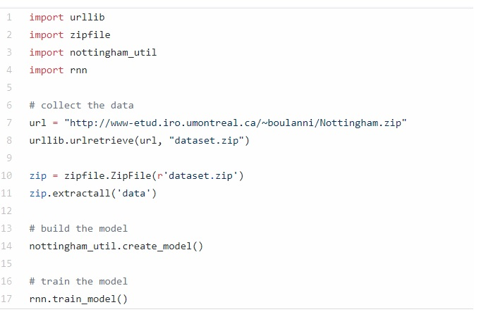
Code/library
recurrent neural network-RNN
tensorFlow
numpy
urllib
fig 1: main code

Slide 5
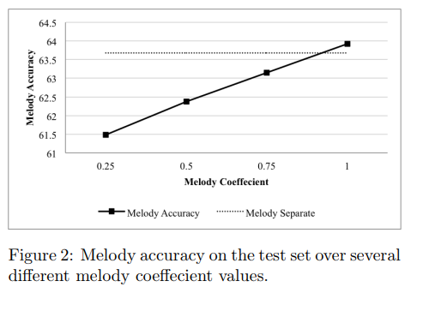
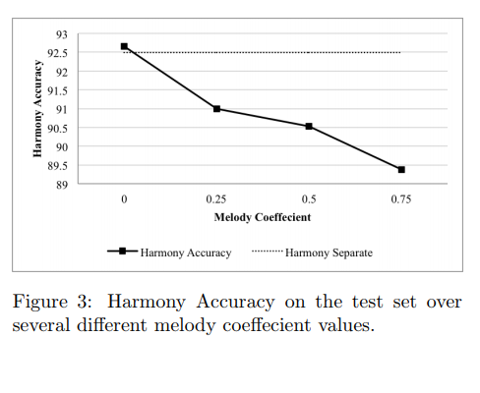
Program

Slide 6
Program
each time step = 88 dimensional binary vector
separated into two parts: a melody and harmony
input vector passes through LSTM cells
train given data in RNN
test and generate new data
Sample outputs

Slide 7
conclusion
77.84% accuracy for the given dataset
will experiment with different dataset

Slide 8
THANK YOU!
Any Queries??

Slide 9
References
1. idea – https://www.youtube.com/watch?v=S_f2qV2_U00&t=122s
2. dataset - https://github.com/llSourcell/AI_Composer
3. code - https://github.com/llSourcell/AI_Composer
4. tutorial- https://www.youtube.com/watch?v=S_f2qV2_U00&t=122s
5. paper - http://yoavz.com/music_rnn_paper.pdf

